Slide 1
Using PowerShell for Application Patching and Deployment Standardization
Andy Jackson & Scott Durham

Slide 2



Introductions
Andy Jackson IT Engineer, Workstation Technologies
Scott Durham IT Engineer, Workstation Technologies

Slide 3



IT Workstation Technologies
Third tier in IT Support structure, also responsible for researching, implementing, and supporting systems used for Workstation Support on campus.
Supported Systems
System Center Configuration Manager (Microsoft Configuration Management)
Jamf Pro (Apple Configuration Management)
PaperCut (Print Management)
Citrix XenApp (Application Virtualization)
Notes:
Scott – ITWT
Andy – Supported Systems

Slide 4
How can we get better?
Process Improvements
Reduce Duplication of Effort
Potential Cost Savings
Notes:
Duplication of effort in deploying applications: people maintain multiples of the same application within SCCM for different uses. One of the solutions we found to address all of these bullet points: PS App Deploy.

Slide 5

Something we noticed…
3rd Party Solution
WSUS Integrated
SCCM
Application 1 Patch
Often the patch is just the full application installer
Application 1 Installer
Software Center
Application 1 Installer
Primary Task Sequence
Application 1 Installer
Duplicate
Notes:
Duplication | Something we noticed specifically surrounding application patching and installation was we really had two systems that at a bits level used the same installation files and customizations. And specifically in SCCM we had multiple different groups creating multiple different copies of the same application, often times using different methods (exe, mis, script.)
Reverse Troubleshooting | One of the recurring issues we would often run into was if something goes wrong with that application you now have to look through several copies of the same app to try and figure out what caused the issue

Slide 6
Goals
Streamline 3rd party app deployment & patching process by having a single system manage app installation and patching
Reduce duplication of effort by eliminating multiple app copies
Potentially save money by eliminating 3rd party solution previously used for app patching

Slide 7
What 3rd Party Applications?
Applications identified as having a high score on our security office’s vulnerability management solution:
7Zip
Adobe Acrobat DC, Reader DC, AIR, Flash Player
Apple iTunes
Google Chrome
Java x86/x64
Mozilla Firefox
Notepad++
VLC

Slide 8
Why not just use SCCM?
Features identified to enhance the app patching process:
Custom Notification Windows
User deferrals
Session aware (not forcibly close apps that are in use)

Slide 9
PowerShell App Deploy
SCCM Integration
Customizable
Built off PowerShell
Notes:
Already works with SCCM
Provides a customizable GUI framework for application deployments
Flexibility to meet the needs of the user while accomplishing our IT needs to patch the system/application
Built off PowerShell – the language that Microsoft builds for all administrative tools
For IT folks, this also provides professional development of learning a new tool in your toolbox

Slide 10
What PowerShell App Deploy Is
PowerShell App Deployment is a toolkit that provides a set of functions to perform common application deployment tasks on Windows.
Under the hood it is a set of PowerShell scripts so it can be integrated with any management system that supports the running of PowerShell scripts.
Best of all, it is free! You can redistribute it and/or modify it under the terms of the GNU Lesser General Public License.
Available for download at PSAppDeployToolkit.com

Slide 11


Why PowerShell App Deploy
Some of the functions the toolkit provides:
App Install Deferrals
Allow the user to defer an installation X number of times.
Application Closures
The ability to prevent the user from launching the applications that need to be closed while the application installation is in progress.
Custom Dialog Boxes
With options to customize title, text, buttons & icons.
Institutional Branding
Everyone likes showing off institutional logos.
Notes:
IE: We just started using PS App Deployment to handle our Windows 10 Feature Pack updates as the preferred delivery method for these updates over WSUS to provide customization and communication during the update regarding a required restart and that the install and restart will each take significant time.

Slide 12
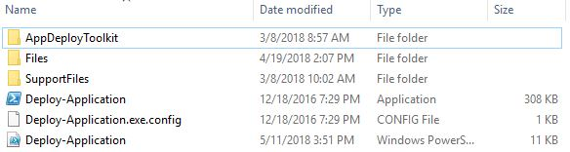
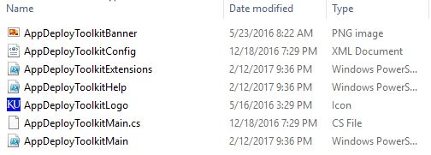
Inside the Toolkit
Five Components of the Toolkit
AppDeployToolkit
Help Script
List of functions
Configuration Settings
Extensions
Branding
Files
This is where you would put your installation files
Support Files
This is where you would put any additional files required for the installation
Deploy-Application.ps1
This is what you will customize for your installation
Deploy-Application.exe
This just kicks off Deploy-Application.ps1
Notes:
Quick overview of the script breakdown

Slide 13
Deploy-Application.ps1
Three Main Sections
Meta Information
Install Tasks
Uninstall Tasks
Notes:
Quick overview of the script breakdown

Slide 14
Meta Data
Plug in the information as you want it to appear and that’s it.
##*===============================================
##* VARIABLE DECLARATION
##*===============================================
## Variables: Application, none of this is shown to the user
[string]$appVendor = 'Adobe'
[string]$appName = 'Reader'
[string]$appVersion = '11.0'
[string]$appArch = 'x64'
[string]$appLang = 'EN'
[string]$appRevision = '01'
[string]$appScriptVersion = '1.0.0'
[string]$appScriptDate = '02/06/2016'
[string]$appScriptAuthor = 'Andy Jackson'
##*===============================================
## Variables: Install Titles (Only set here to override defaults set by the toolkit)
[string]$installName = 'AdobeReader11.0'
[string]$installTitle = 'Adobe Reader 11.0' # Displays to the user in boxes
Notes:
More icons available at:

Slide 15
Pre-Installation Section
Define apps to close for install
Number of deferrals
Check Disk Space
##*===============================================
##* PRE-INSTALLATION
##*===============================================
[string]$installPhase = 'Pre-Installation'
## Show Welcome Message, close Internet Explorer if required, allow up to 3 deferrals, verify there is enough disk space to complete the install, and persist the prompt
## NOTE: By default the "-MinimizeWindows" parameter is set to $true. You most likely want to set this to $false so it doesn't minimize all the user's windows
Show-InstallationWelcome -CloseApps 'iexplore' -AllowDefer -DeferTimes 3 –CheckDiskSpace -PersistPrompt -MinimizeWindows $False
## Show Progress Message (with the default message)
Show-InstallationProgress
Notes:
More icons available at:

Slide 16
Installation Section
Define the installer (msi or exe) and applicable switches (/q or /qn.) –Path is relative to the “Files” folder in the toolkit.
##*===============================================
##* INSTALLATION
##*===============================================
[string]$installPhase = 'Installation'
## <Perform Installation tasks here>
Execute-MSI -Action Install -Path 'AdbeRdr11000_en_US.msi' -AddParameters '/q'
## EXE Install Example: Execute-Process -Path 'Setup.exe' -Parameters '/S'
Notes:
More icons available at:

Slide 17
Post-Installation Section
Copy default settings
Remove desktop shortcut
##*===============================================
##* POST-INSTALLATION
##*===============================================
[string]$installPhase = 'Post-Installation'
## <Perform Post-Installation tasks here>
# Copy preference files
If (Test-Path -Path (${env:ProgramFiles} + "\Google\Chrome\Application")){
Copy-File -Path "$dirSupportFiles\master_preferences" -Destination (${env:ProgramFiles} + "\Google\Chrome\Application")
}
# Remove desktop link
If(Test-Path -Path "C:\Users\Public\Desktop\Google Chrome.lnk"){
Remove-File -Path "C:\Users\Public\Desktop\Google Chrome.lnk"
}
Notes:
More icons available at:

Slide 18
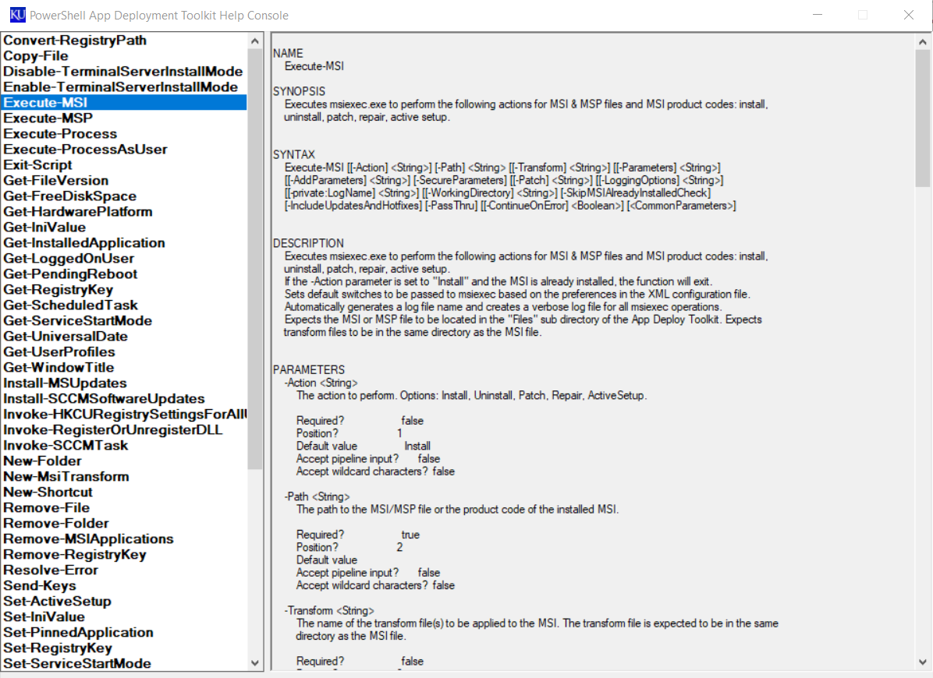
AppDeployToolkitHelp.ps1
Some of the added functions:
Execute-MSI
Execute-MSP
Get-InstalledApplication
Invoke-SCCMTask
New-Shortcut
Remove-MSIApplications
Show-DialogBox
Show-InstallationProgress
Show-InstallationWelcome
Test-Battery
Update-GroupPolicy
Write-Log
Notes:
More icons available at:

Slide 19
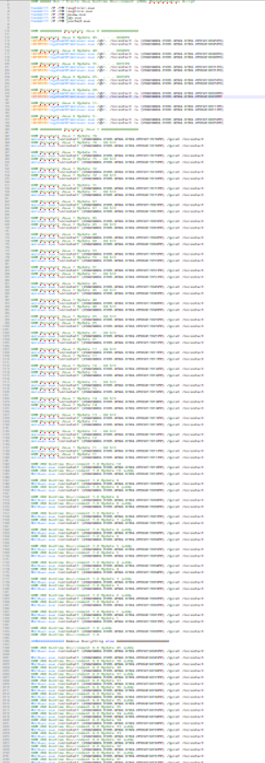
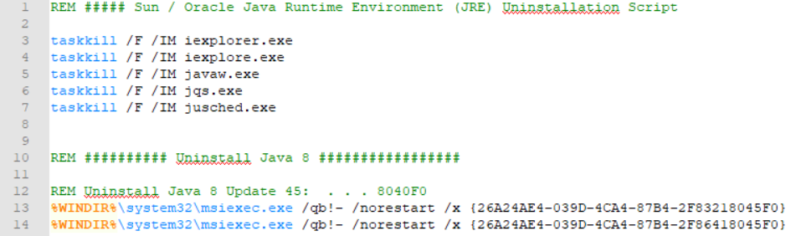
Example Old Method Uninstallation Script
Notes:
More icons available at:

Slide 20
Uninstallation Section
## <Perform Uninstallation tasks here>
Remove-MSIApplications -Name 'Java(TM)'
Remove-MSIApplications -Name 'Java 6'
Remove-MSIApplications -Name 'Java 7'
Notes:
More icons available at:

Slide 21
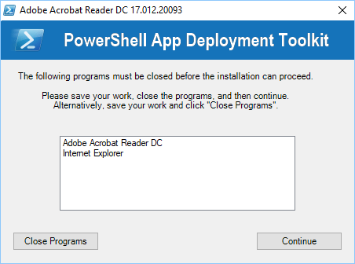
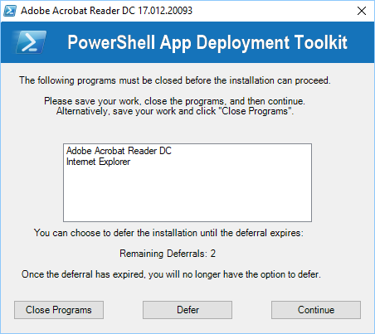
Installation Welcome
Set to require closing of Acrobat Reader and IE.
Same, but with deferrals.
Notes:
More icons available at:

Slide 22
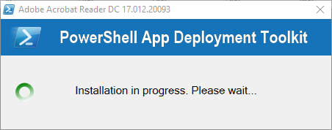
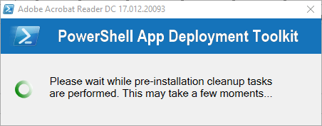
Installation Progress
Can be set to dynamically update to indicate the stage of the installation.
Notes:
More icons available at:

Slide 23
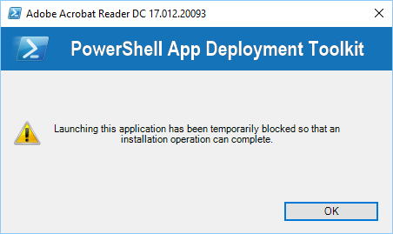
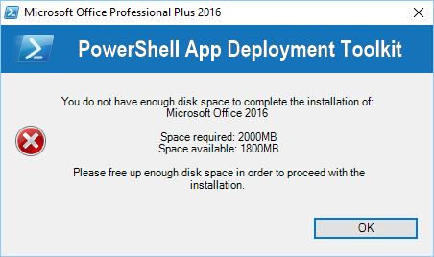
Block Application Execution and Disk Space
Notes:
More icons available at:

Slide 24
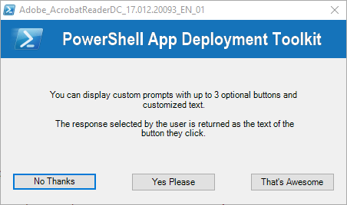
Custom Prompt
Depending on which button is clicked you can then use that in your script.
Notes:
More icons available at:

Slide 25
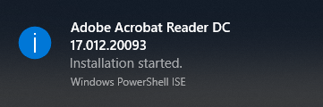
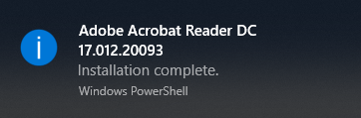
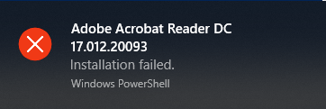
Balloon “Toast” Notifications
Notes:
More icons available at:

Slide 26

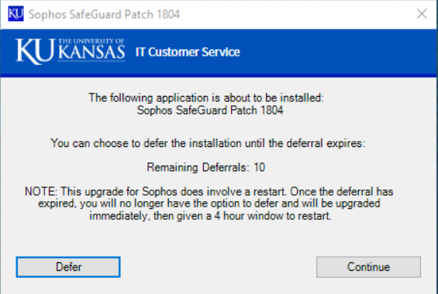
Branding
Notes:
More icons available at:

Slide 27
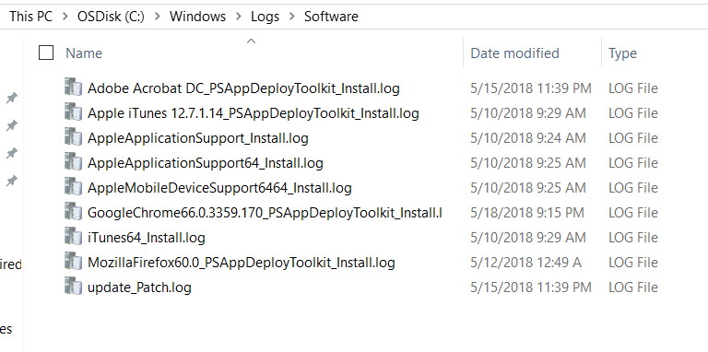
Logs
Every time PSAppDeploy runs it creates a unique log file for each application in C:\Windows\Logs\Software
Notes:
More icons available at:

Slide 28

Demonstration
Notes:
The same 3 components exist for uninstalling an application, but enough of the boring stuff…let’s look at a demonstration!!
* Show off interactive and silent application updates…

Slide 29
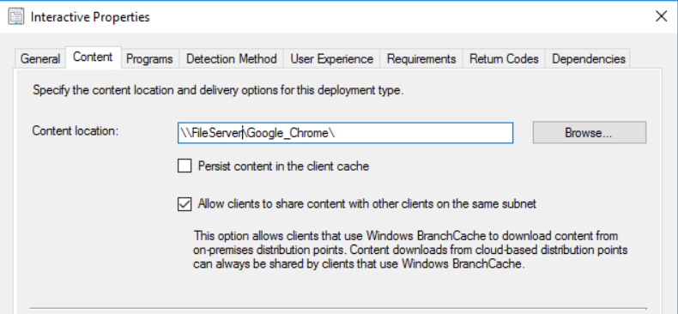
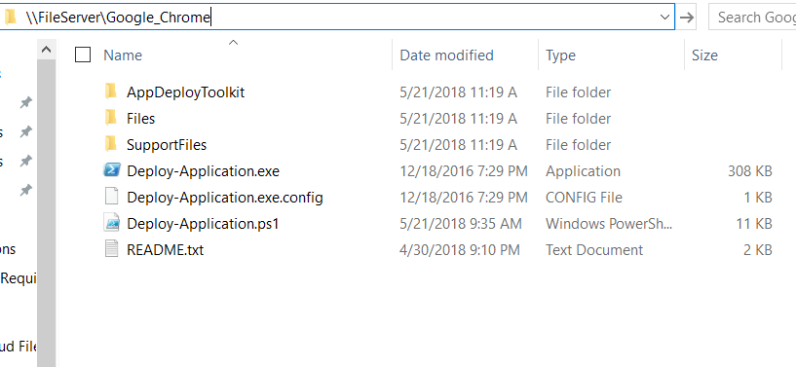
SCCM Integration | Source Files
Deploying an application using PSAppDeploy via SCCM is actually fairly simple.
Properties of an SCCM Application
Customized PSAppDeploy Folder

Slide 30
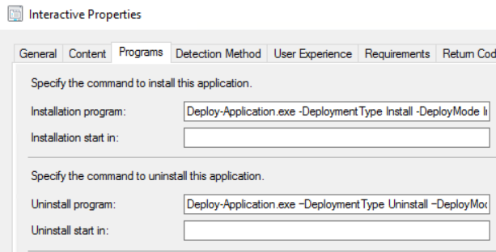
SCCM Integration | Installation Program
Properties of an SCCM Application
Install: Deploy-Application.exe -DeploymentType Install -DeployMode Interactive
Uninstall: Deploy-Application.exe –DeploymentType Uninstall –DeployMode Interactive

Slide 31
SCCM Integration | Global Conditions
We use SCCM Global Conditions to check if various applications are running at the time of the installation to determine if the patch should run silent, or interactive.
[bool](get-process -Name 'chrome' -ErrorAction SilentlyContinue)

Slide 32

SCCM Integration | Deploy Mode
Based on if a user is logged on, and if the application needing an update is in use.
Silent Install:
Deploy-Application.exe –DeploymentType Install –DeployMode Silent
Interactive Install:
Deploy-Application.exe
–DeploymentType Install –DeployMode Interactive

Slide 33
Deployment Overview
Configuration Baseline
PowerShell based “query” to check if specific application version (or higher) is installed or not, and report back compliance.
Deploy Baseline to all Windows Workstations
Create “Non-Compliant” Collection
Group of computers with an out-of-date version of the targeted application.
Deploy Application Update
Notes:
If you’re using SCCM, baselines are not the only method that can be used for creating the necessary collections for deploying applications but we believe it is the most efficient for our environment.
You can simply create a collection based on a query to search for a particular program and version; baselines and non-compliant collections break this up but, for us, allows a much faster update cycle.

Slide 34
SCCM – Configuration Baseline
Configuration Item (component of a baseline)
Script Components
Is the application installed?
Is the application version current?
Return compliance
If (Test-Path -Path (${env:ProgramFiles} + "\Notepad++\notepad++.exe")) {
# Obtain version of NPP currently installed
$NPPVer = [System.Version](((Get-Item (${env:ProgramFiles} + "\Notepad++\notepad++.exe")).VersionInfo.fileversion))
# Set NPP Compliance to $true if current version is installed
If ($NPPVer -ge "7.5.4.0") { $NPPCompliant = $true }
# Else set the NPP Compliance to $false
Else { $NPPCompliant = $false }
}
# Set NPP Compliance to $true if no existing NPP install so that baseline deployments are ignored.
Else { $NPPCompliant = $true }
# Return compliance
$NPPCompliant
Notes:
If you’re using SCCM, baselines are not the only method that can be used for creating the necessary collections for deploying applications but we believe it is the most efficient for our environment.
You can simply create a collection based on a query to search for a particular program and version; baselines and non-compliant collections break this up but, for us, allows a much faster update cycle.

Slide 35
Ringed Deployment Model
Internal Testing (few days)
Early Adopters (one week)*
Production
* Opt-in group of users who are responsible for testing new application patches in an attempt identify issues and delay the deployment of a patch until the issues can be resolved.
Notes:
More icons available at:

Slide 36
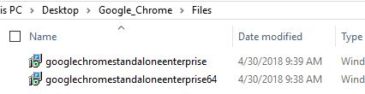
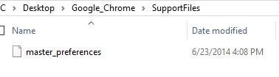
Reusability
When new updates come out for an application, all you have to do to your existing template is:
Replace the installation files with the updated files
Adjust the version numbers in your scripts (Deploy-Application.ps1, and Configuration Baseline)
Deploy
You can also save time by standardizing file names:
Files Folder
SupportFiles Folder
Notes:
More icons available at:

Slide 37
Windows Feature Packs with PS App Deploy
Same PowerShell script with a few changes
##*===============================================
##* INSTALLATION
##*===============================================
[string]$installPhase = 'Installation'
## <Perform Installation tasks here>
$SETUP = Execute-Process -Path "setup.exe" -Parameters '/Auto Upgrade /Quiet /NoReboot /DynamicUpdate disable' -PassThru -ContinueOnError $true
if ($SETUP.ExitCode -ne 0){
Write-Host "Windows setup finished with a non-0 exit code" -ForegroundColor Red
Exit-Script -ExitCode 69002 #Generic failure.
}
Notes:
More icons available at:

Slide 38
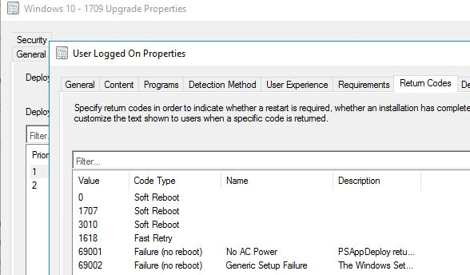
Windows Feature Packs with PS App Deploy
Return Codes
In short, require a Soft Reboot
Notes:
More icons available at:

Slide 39
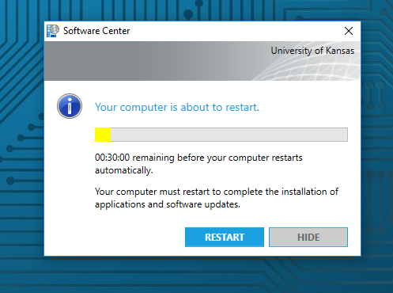
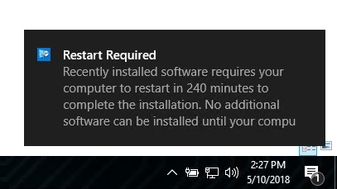
SCCM Client Soft Reboot
Soft reboot behavior (times controlled by SCCM client settings)
Notes:
More icons available at:

Slide 40
Deployment Standardization
Single System (SCCM)
Single Application
Software Center
Task Sequence
Patching
Notes:
More icons available at:

Slide 41
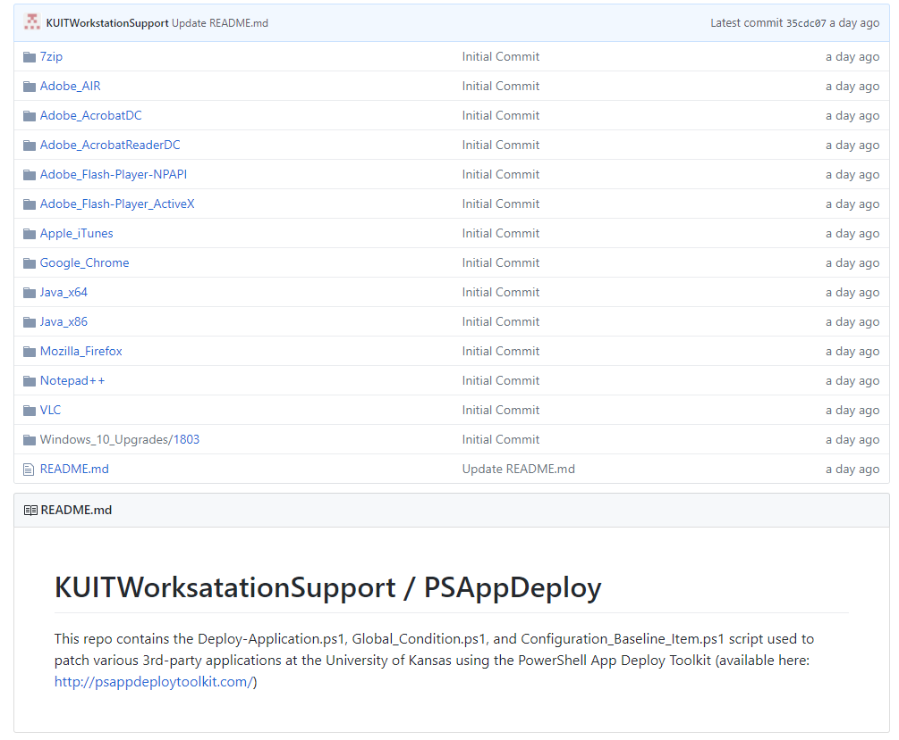
Everything is available on our GitHub page
https://github.com/KUITWorkstationSupport/PSAppDeploy
Notes:
More icons available at:

Slide 42



Icons designed by Madebyoliver from Flaticon.
Notes:
Questions?

